Slide 1
DESCRIBING PEOPLE Physical appearance
What does he/she look like?

Slide 2
HEIGHT
tall
short
of medium height

Slide 3
BUILD
AGE
young
middle aged
old
a teenager
in his/her 20s, 30s, etc.
fat / overweight
slim / thin
skinny
muscular

Slide 4
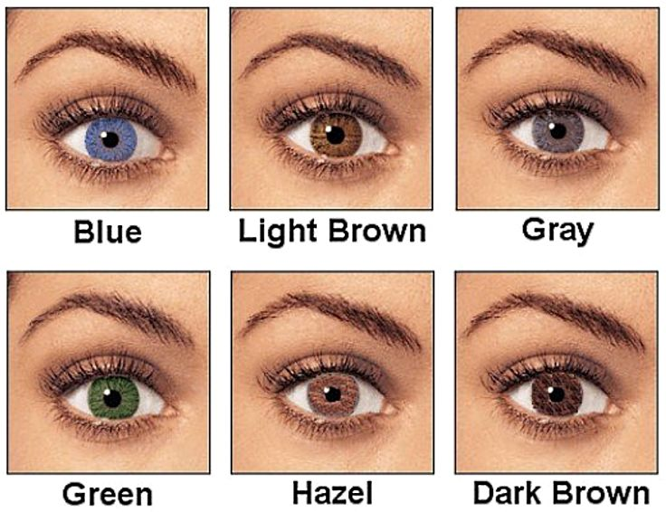
EYES
brown
green
blue

Slide 5
HAIR
dark/fair hair
brown
blonde
black
red/ginger
grey, white
long
short
shoulder length
straight
wavy
curly
bald
a fringe
a ponytail
a plait/a braid

Slide 6
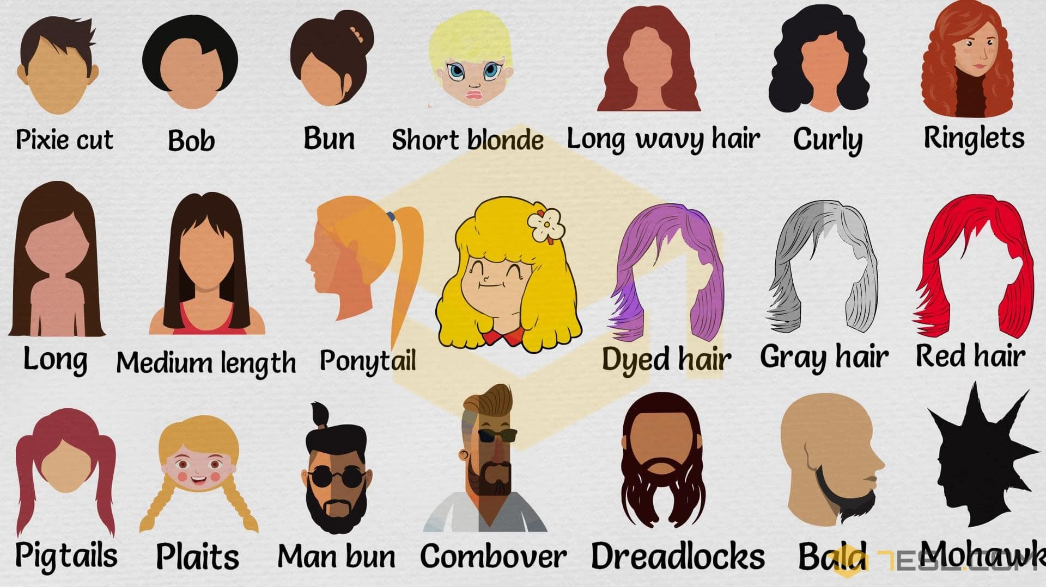

Slide 7
SPECIAL FEATURES
a beard
a moustache
wear glasses
freckles
wrinkles
pimples
a scar
a tattoo

Slide 8
GENERAL DESCRIPTION
beautiful
handsome
good-looking
pretty
attractive
plain

Slide 9
What about you, what do you look like?

