Slide 1
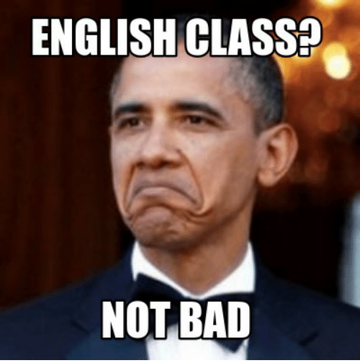
Week 6
Students,
I hope that you feel like Obama on this picture when starting a new English lesson.
I know I certainly do! ☺
Teacher Polona
https://me.me/i/english-classa-not-bad-meme-creator-funny-english-class-45dacde0380a46378db30103541f3bfc

Slide 2
Wednesday, 22nd April
Do exercises 1, 2 and 3 in your workbook, page 58.
To get the answer key go to:
https://www.mladinska.com/sola/center_oxford/resitve

Slide 3
Thursday, 23rd April
Do exercises 4, 5, 6 and 7 in your workbook, page 59.
To get the answer key go to:
https://www.mladinska.com/sola/center_oxford/resitve

Slide 4
Friday, 24th April
Watch the two videos to understand generation gap even better:
https://www.youtube.com/watch?v=v54eKUWAx4M
https://www.youtube.com/watch?v=wo42o1H7KZQ

