Slide 1
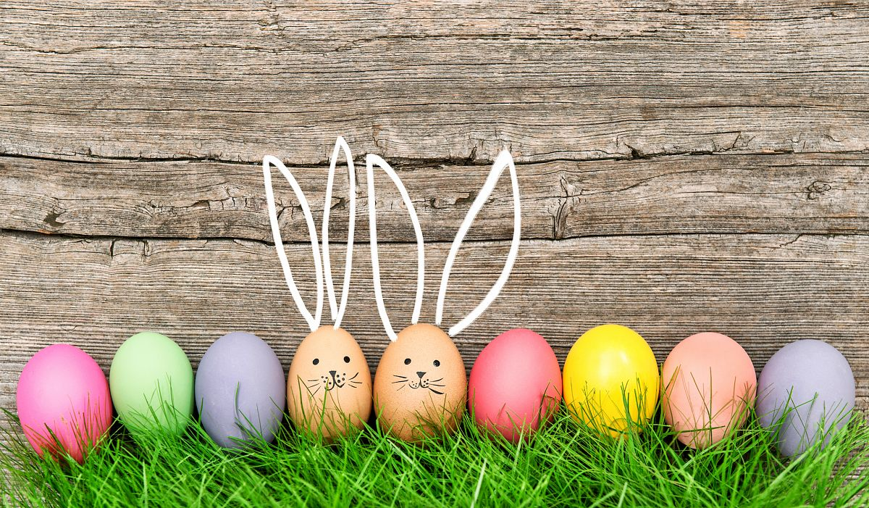
EASTER

Slide 2
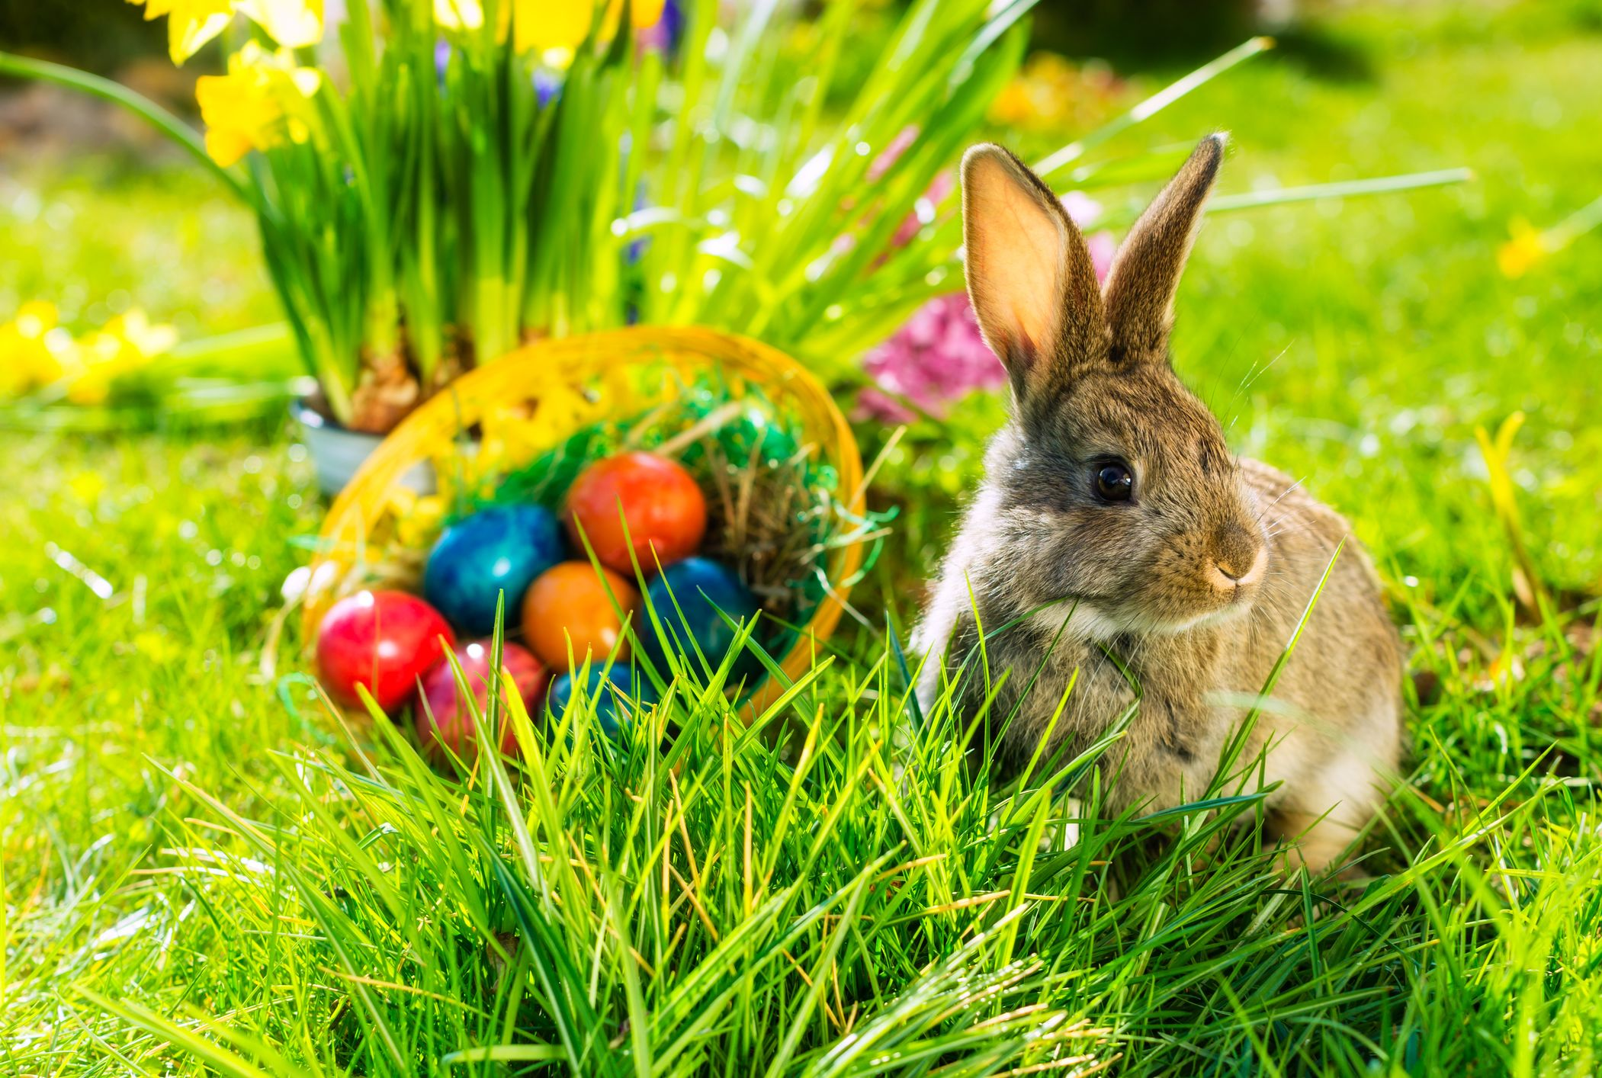
Easter Bunny

Slide 3
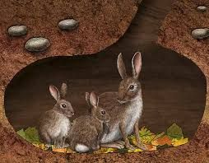
a burrow

Slide 4
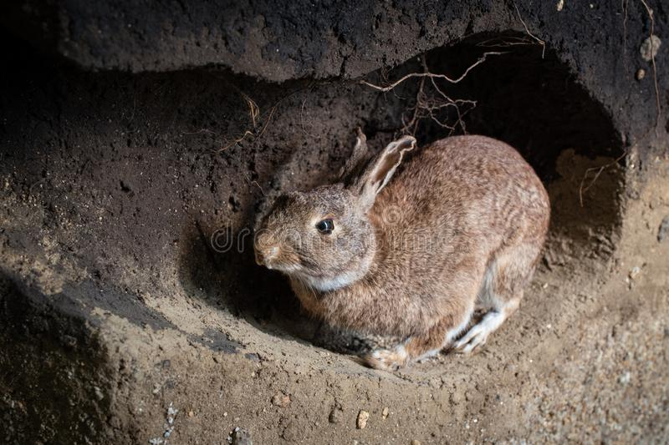
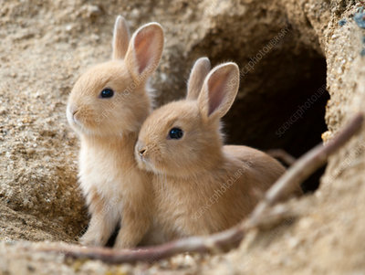
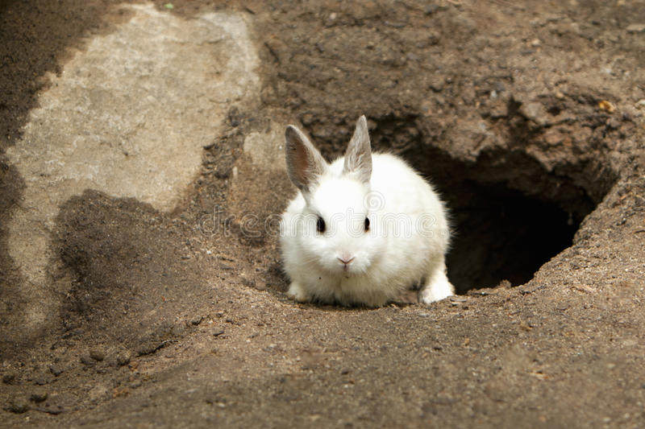

Slide 5
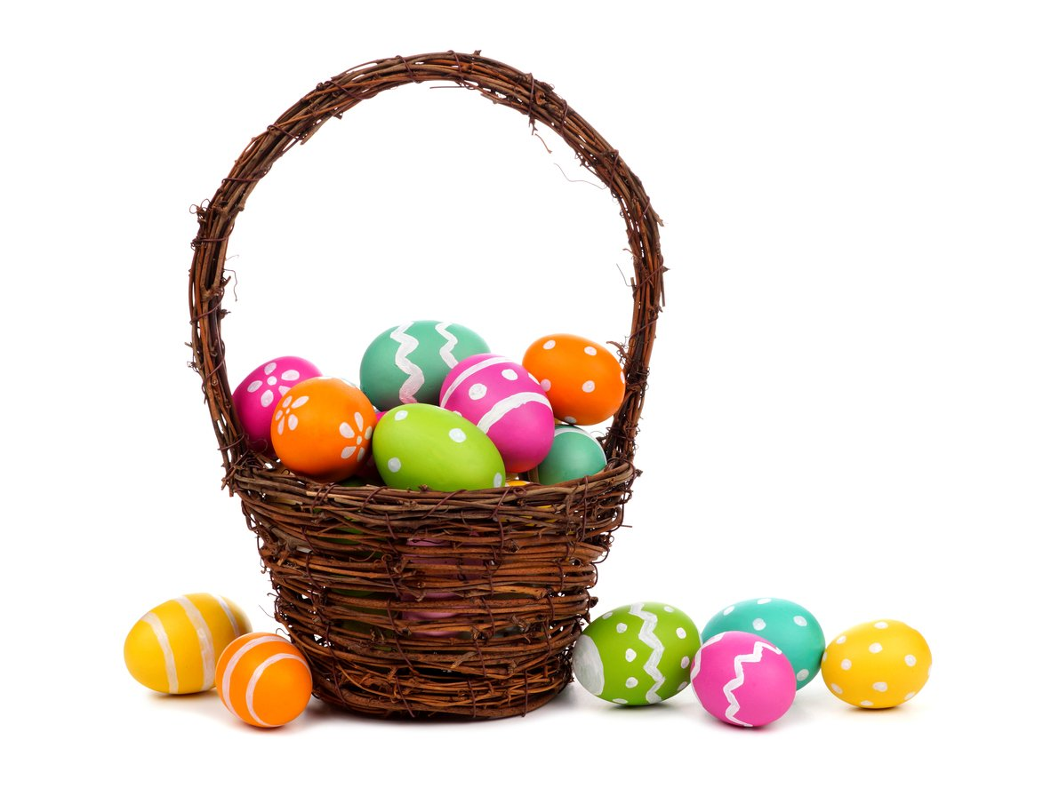
a basket

Slide 6
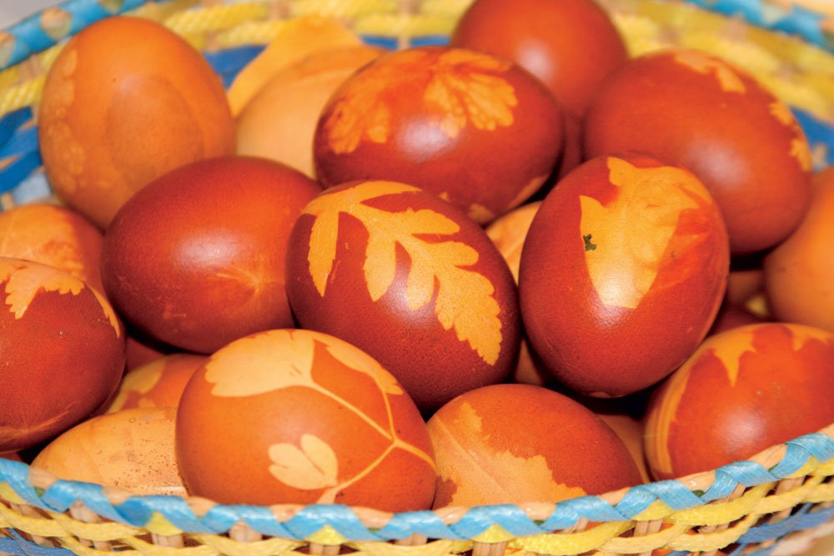
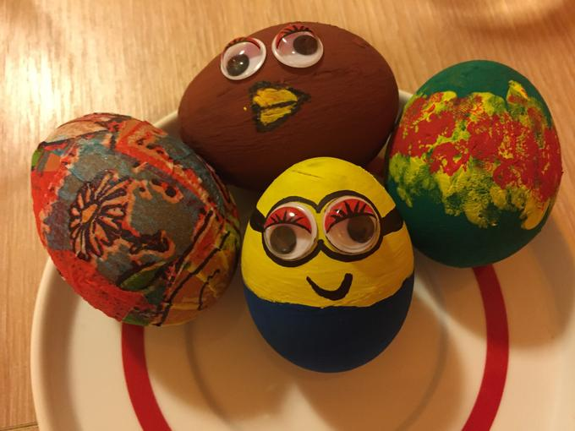
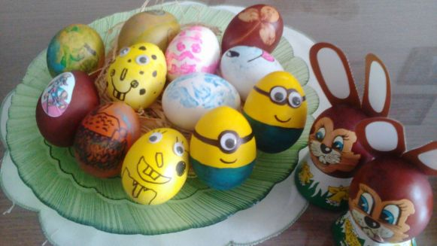
Easter eggs

Slide 7
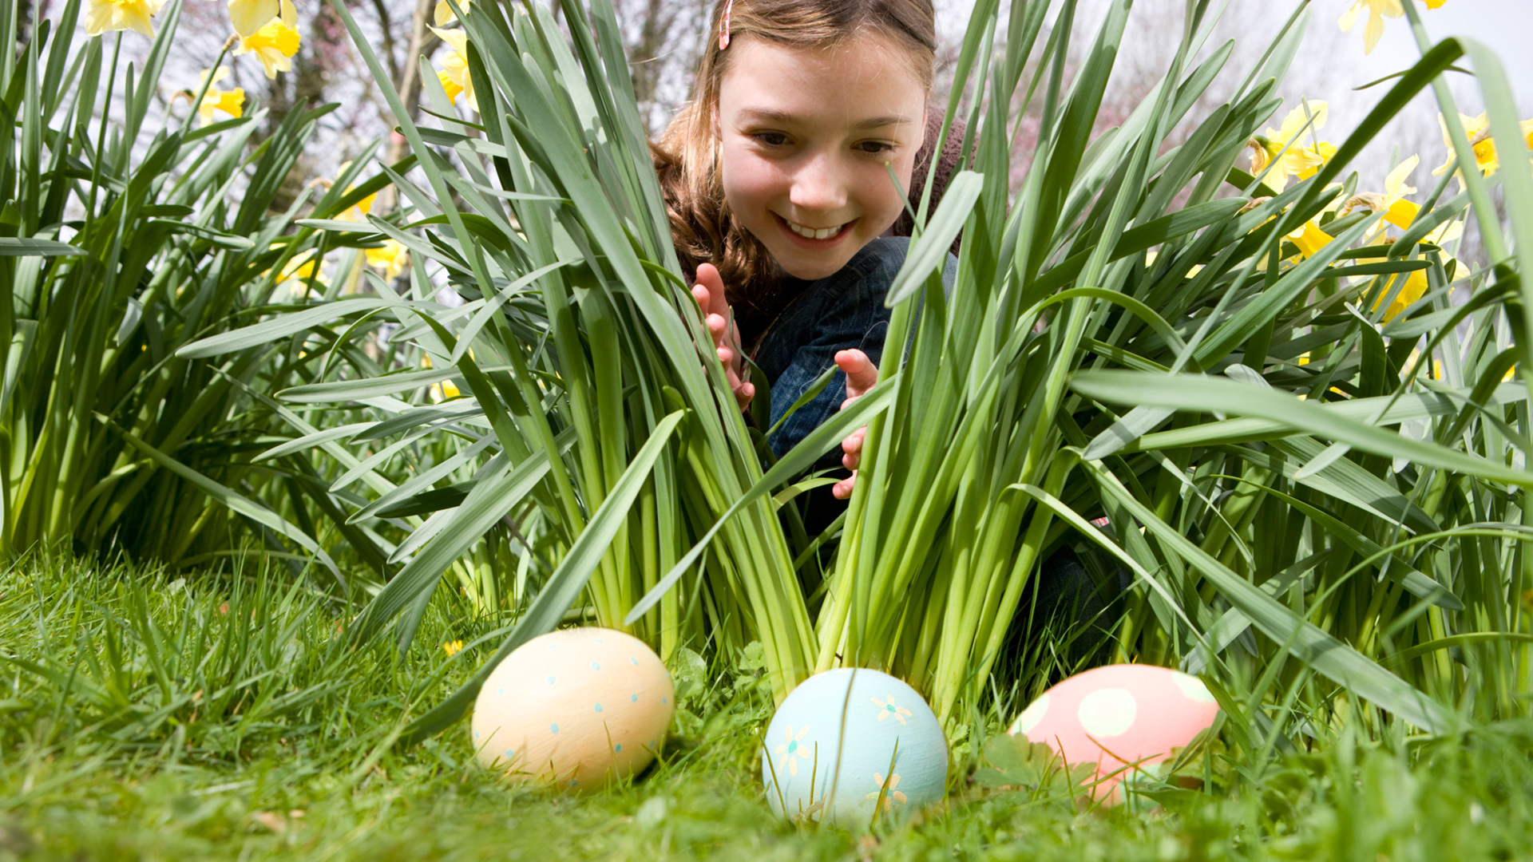
Easter egg hunt

Slide 8
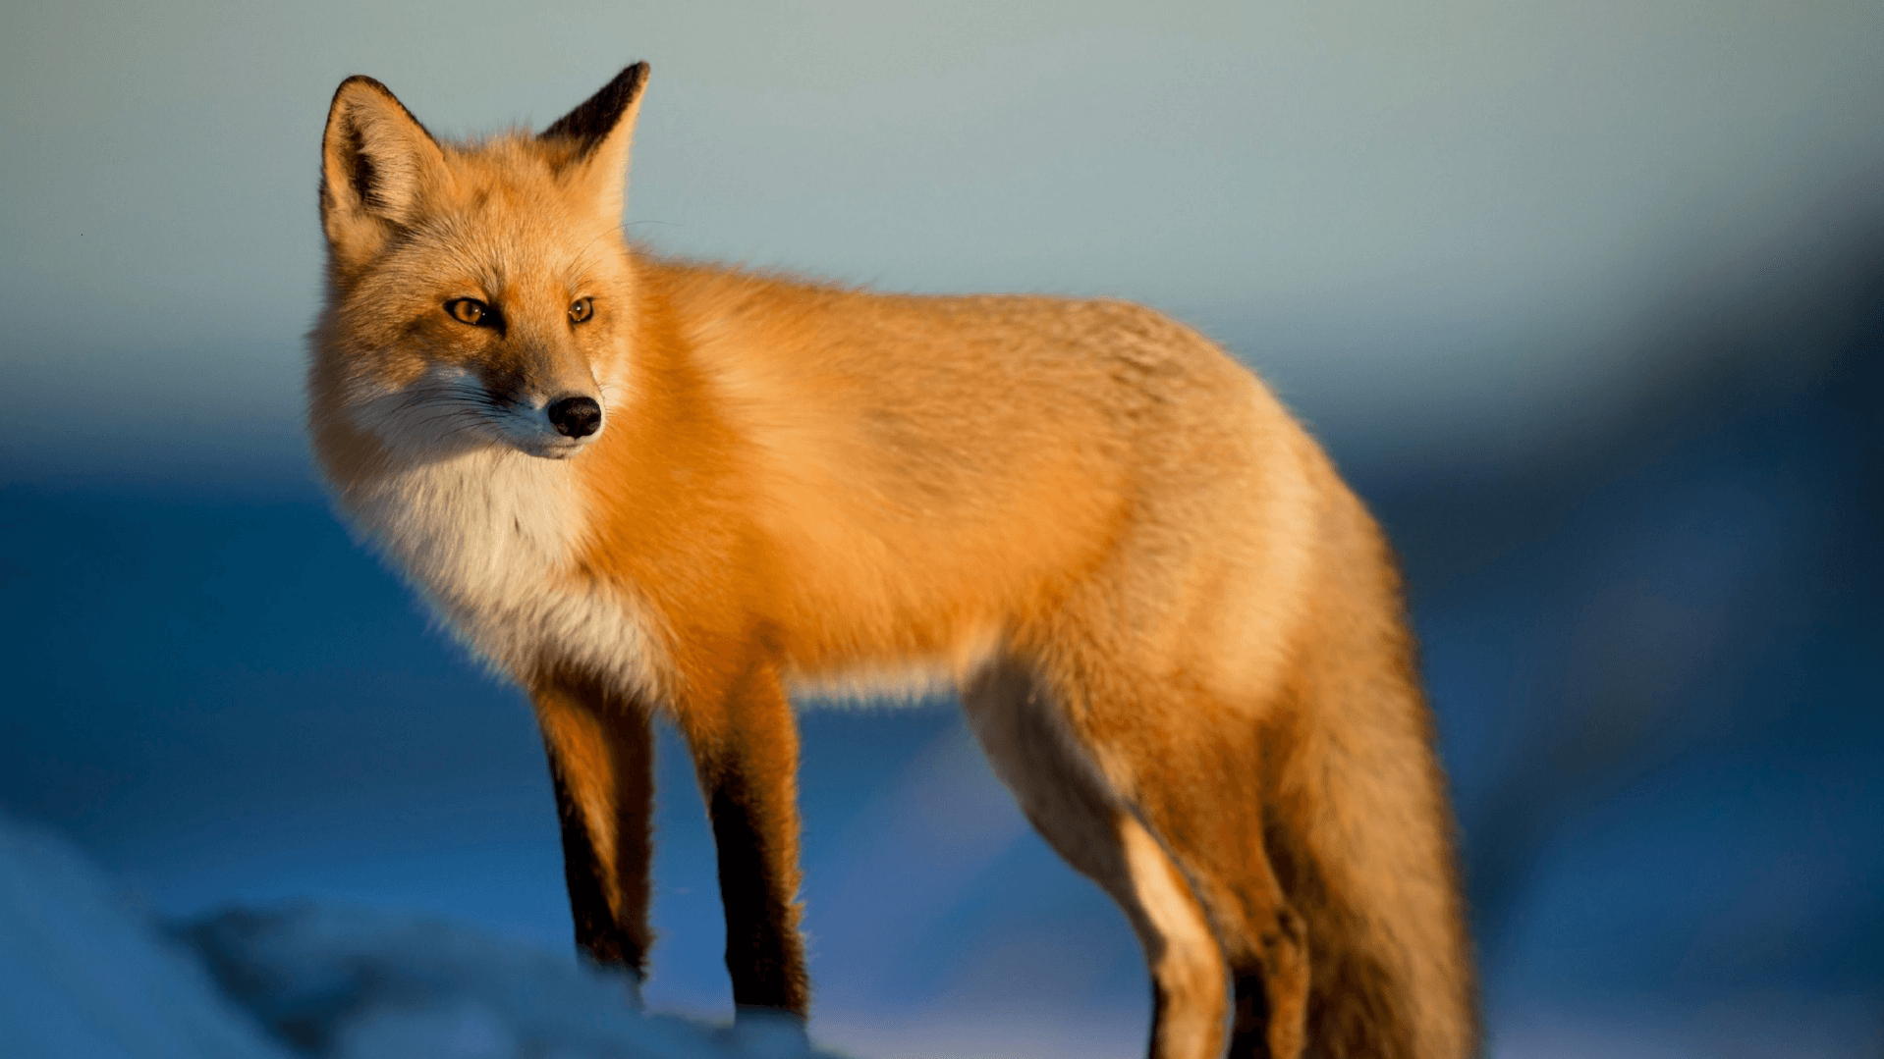
a fox

Slide 9
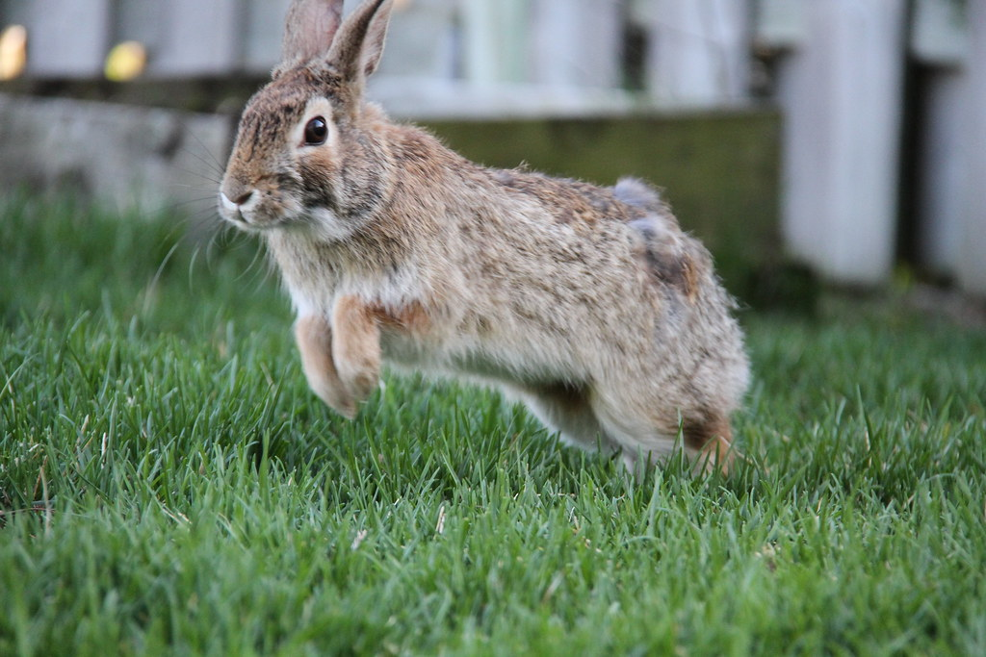
a hop

Slide 10
a hop game
Make four hops.
Make seven hops.
Make two hops.
Make five hops.

Slide 11
right

Slide 12
left

Slide 13
forward

Slide 14
back

Slide 15
a hop game
Make two hops forward.
Make four hops to the left.
Make five hops to the right.
Make one hop back.
....

Slide 16
Easter puppy parade
https://www.youtube.com/watch?v=OW6nYdhqG4Y

