Slide 1
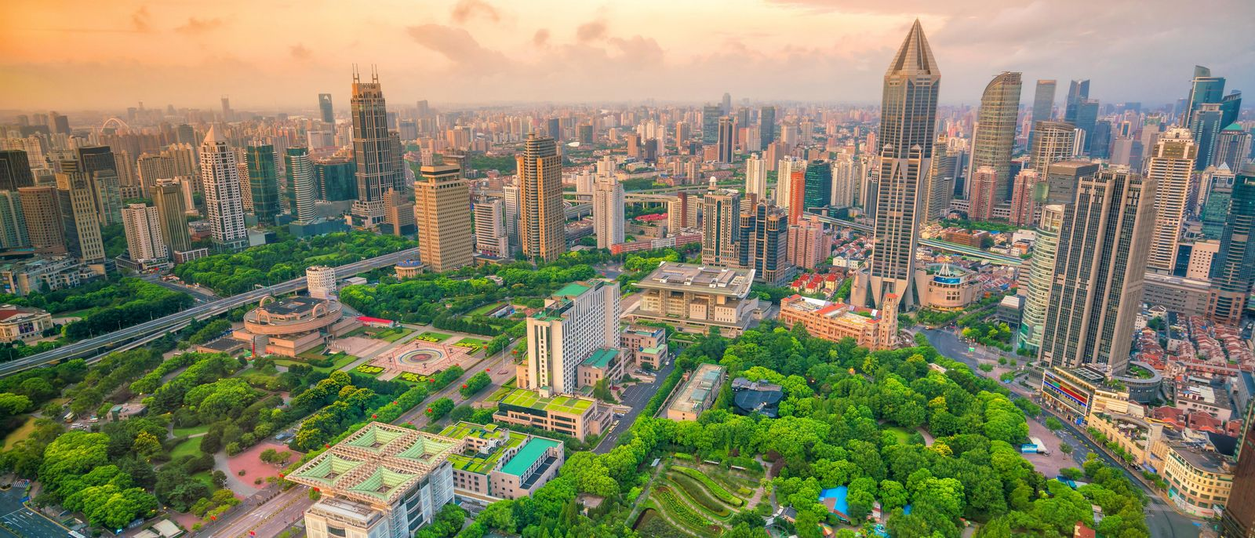
CITY

Slide 2
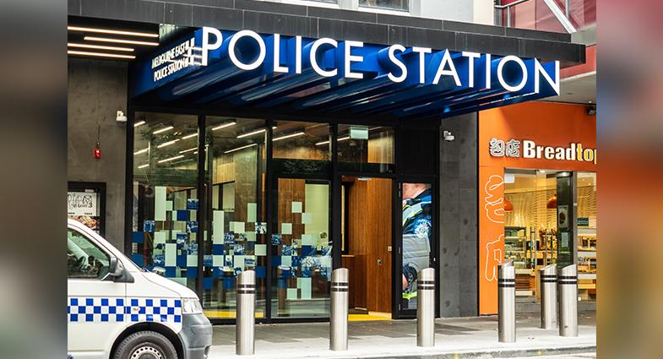
a police station

Slide 3
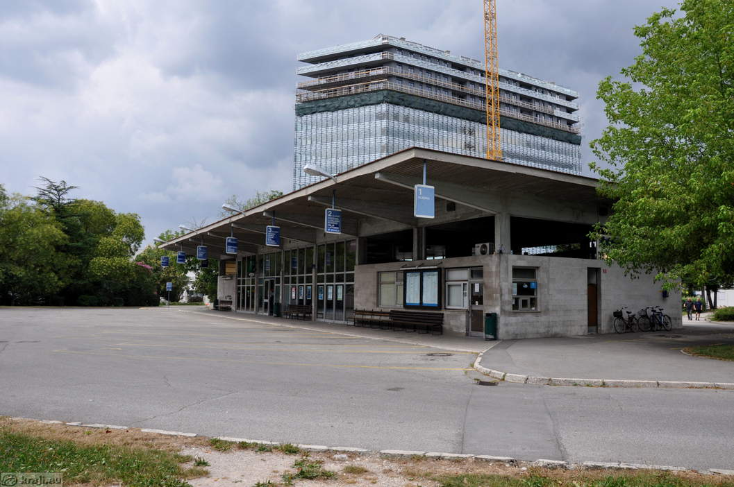
a bus station

Slide 4
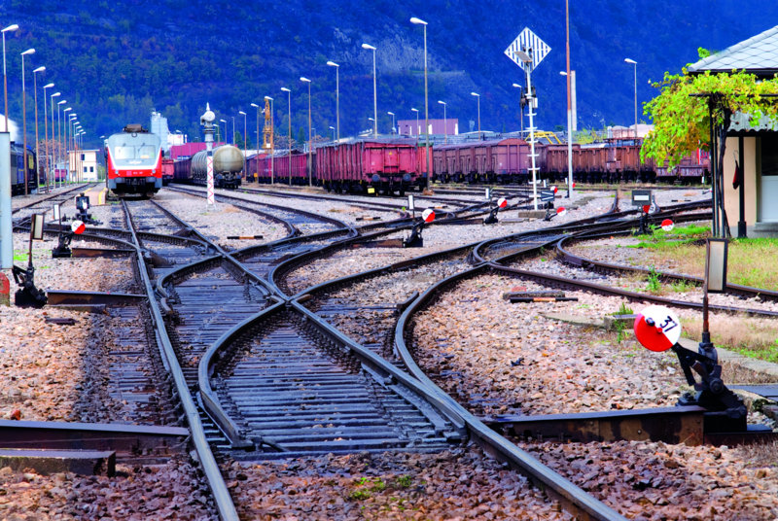
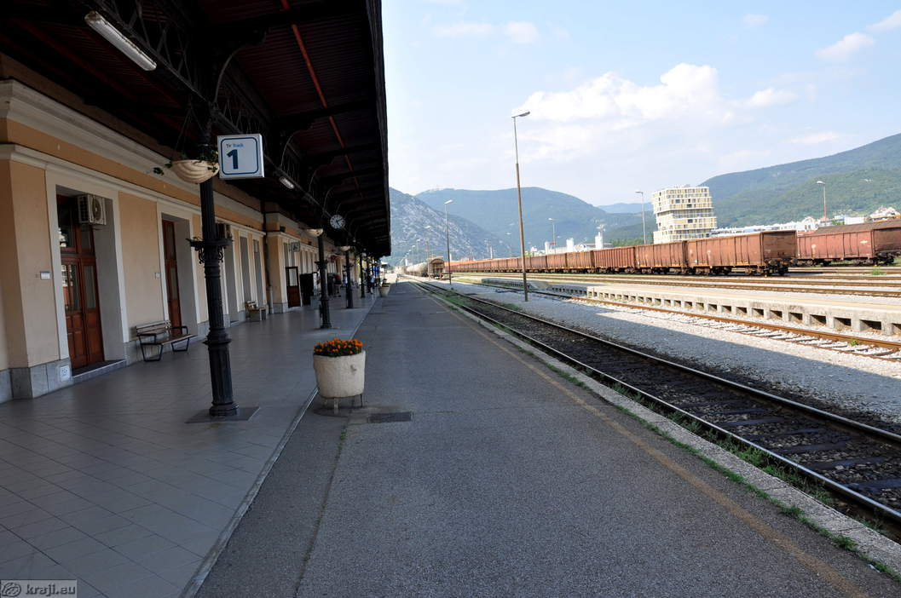
a train station

Slide 5
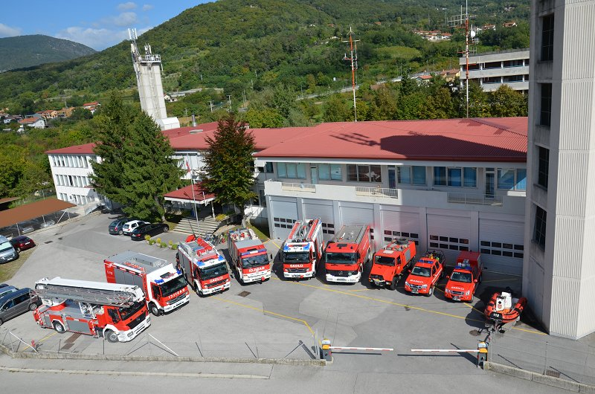
a fire station

Slide 6
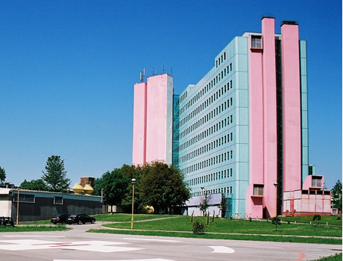
a hospital

Slide 7
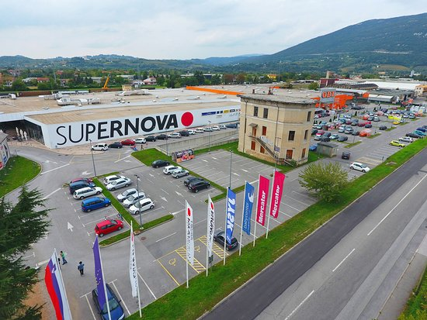
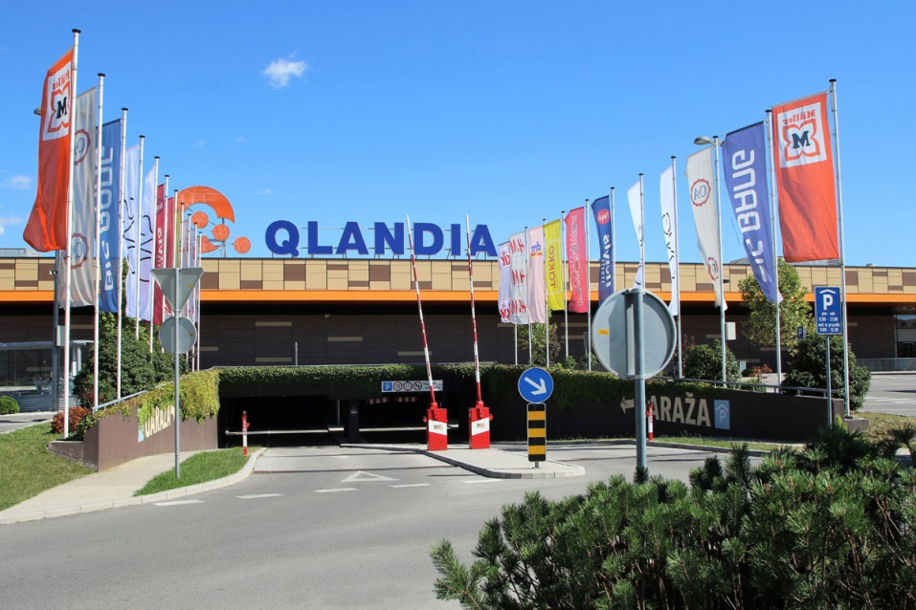
a shopping centre – trgovinski center a shop - trgovina

Slide 8
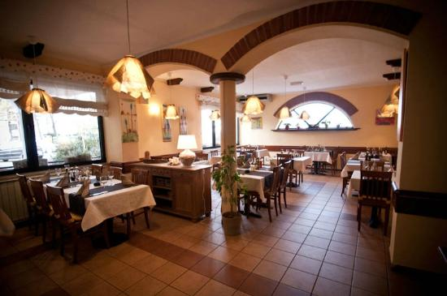
a restaurant

Slide 9
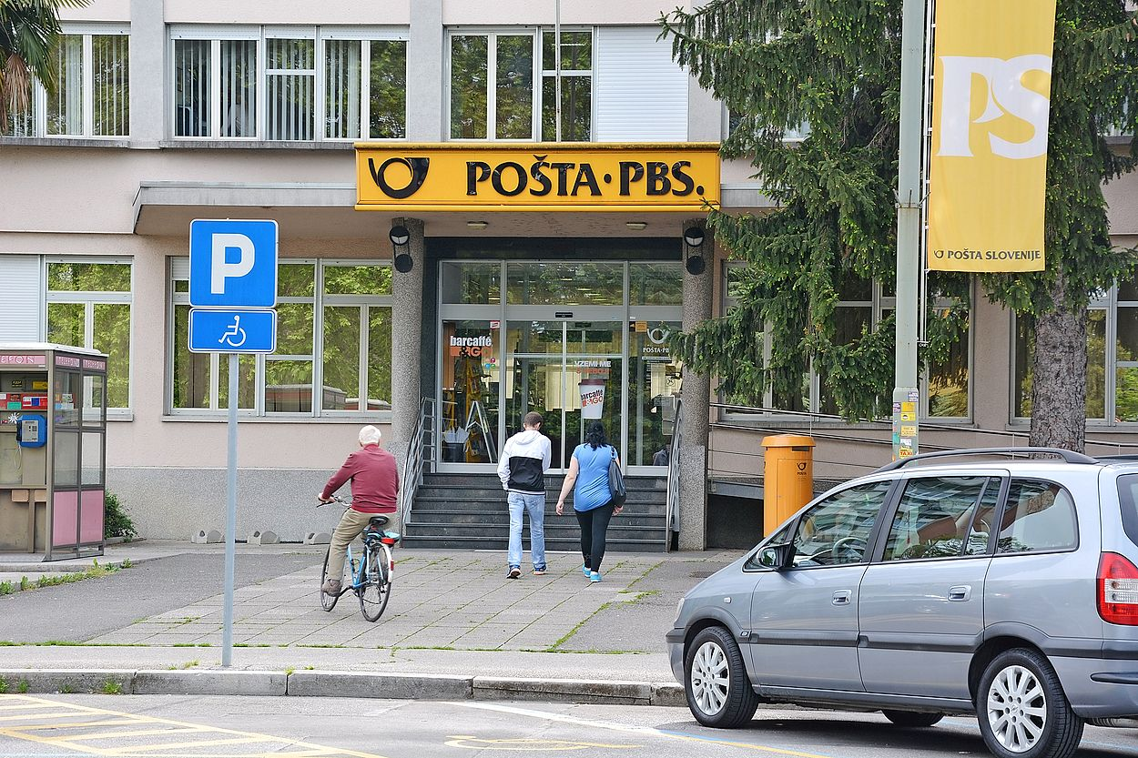
a post office

Slide 10
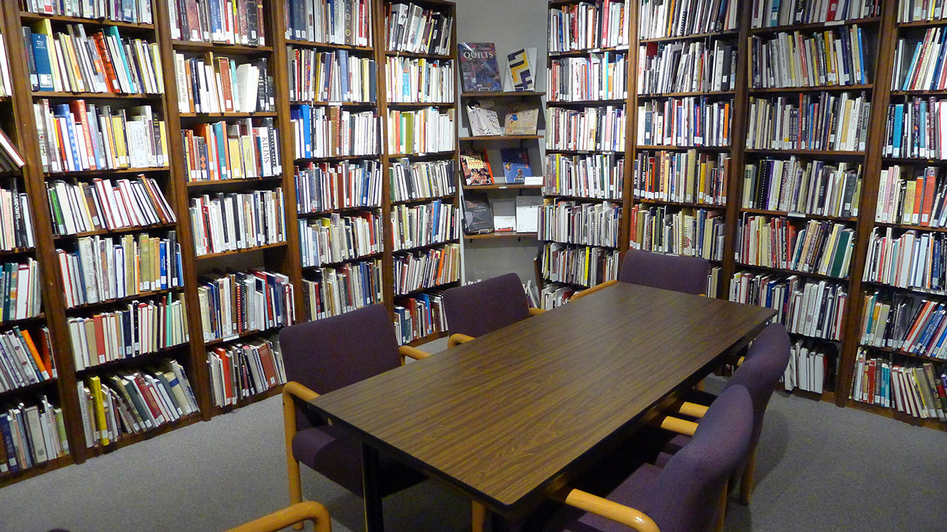
a library

Slide 11
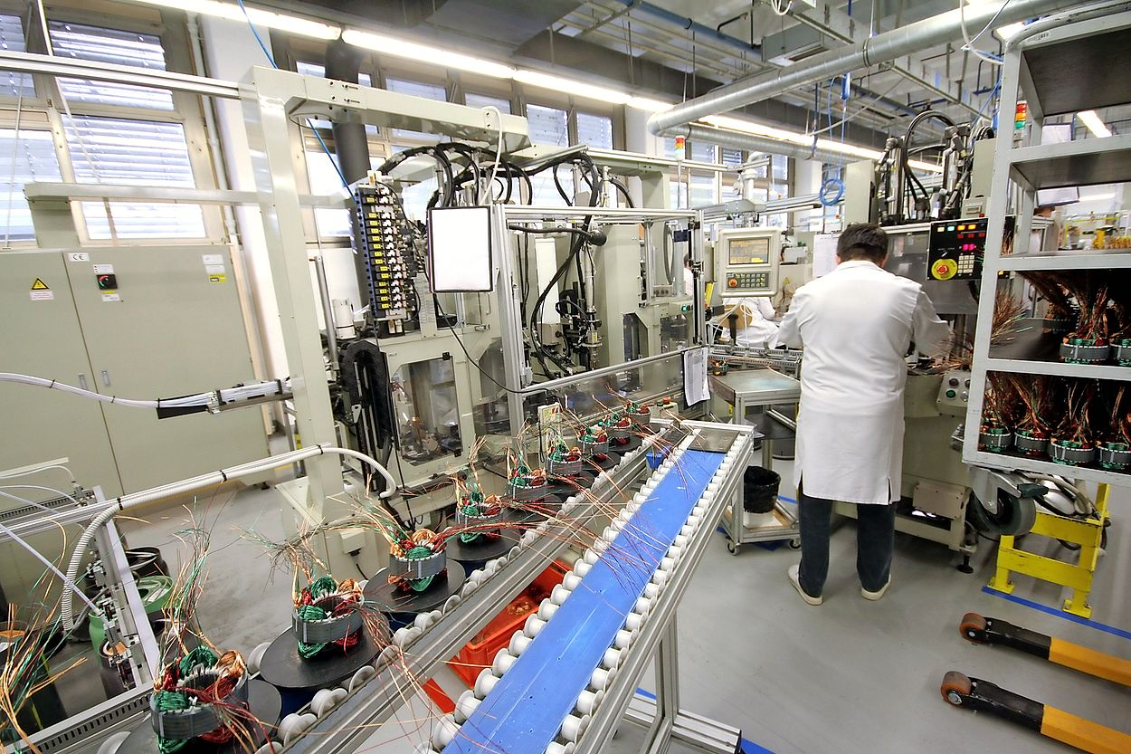
a factory

Slide 12
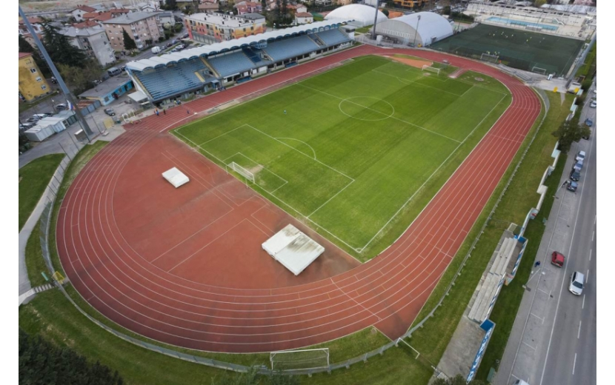

Slide 13
BUILDINGS QUIZ

Slide 14
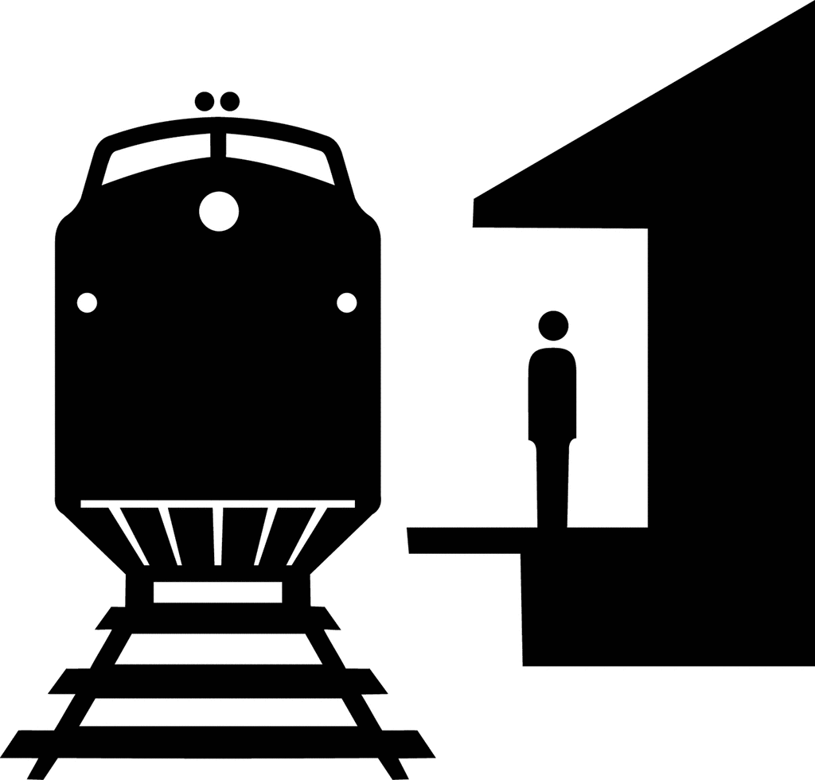
a post office
A)
B)
C)

Slide 15
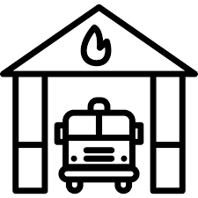
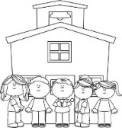
a fire station
D)
E)
F)

Slide 16
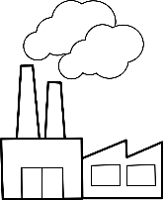
a factory
J)
K)
L)

Slide 17
a library
M)
N)
O)

Slide 18
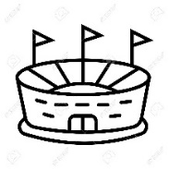
a restaurant
P)
Q)
R)

Slide 19
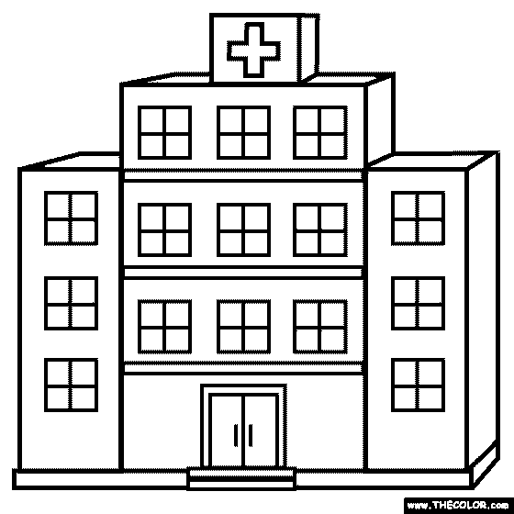
a hospital
S)
T)
U)

Slide 20
a shop
V)
W)
X)

Slide 21
a stadium
Y)
Z)
A)

