Slide 1
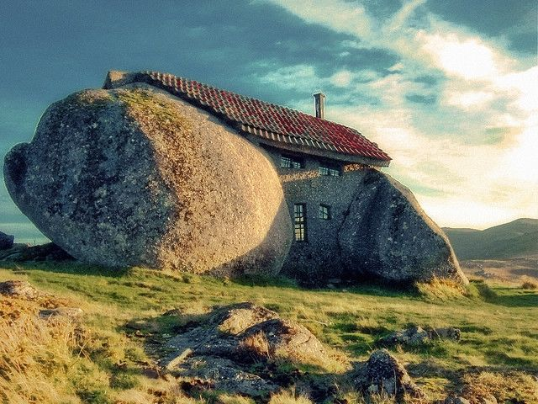
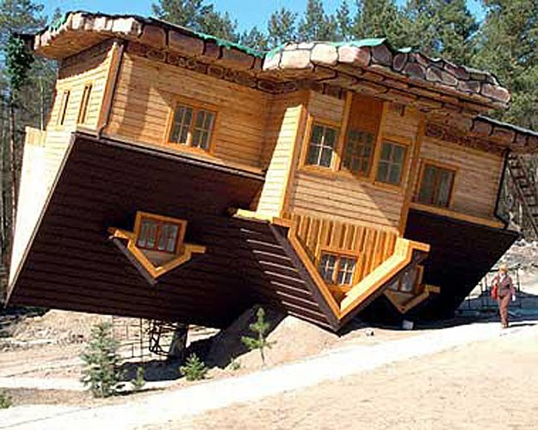
MY DREAM HOUSE

Slide 2
LET‘S REVISE – click on the picture

Slide 3
ROOMS
an attic
a basement
a backyard
a bathroom
a bedroom
a dining room
a garage
a garden
a hall / a hallway
a kitchen
a living room
an office
a roof
stairs
a toilet
a utility / laundry room

Slide 4
➔ the ground floor
the first floor ⬅

Slide 6
OUR HOUSE
Click on the picture and solve the exercises.

Slide 7
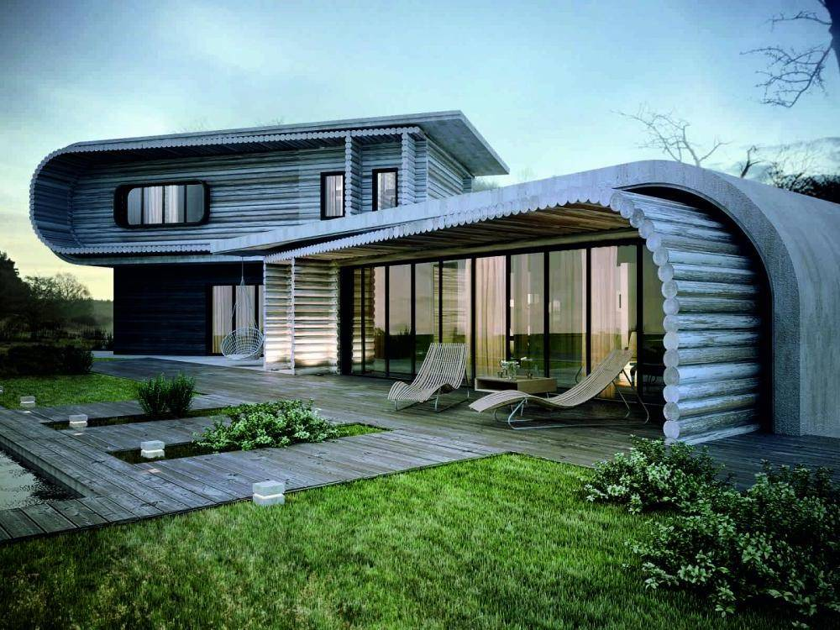
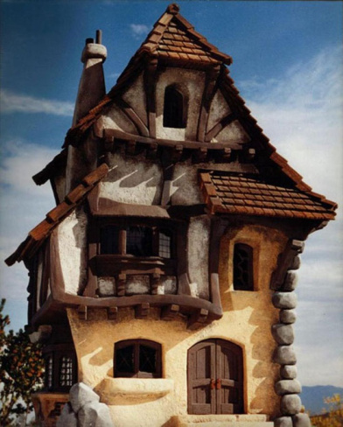
BEING AN ARCHITECT OF MY DREAM HOUSE
Make a sketch of your dream house. Name the rooms.

Slide 8
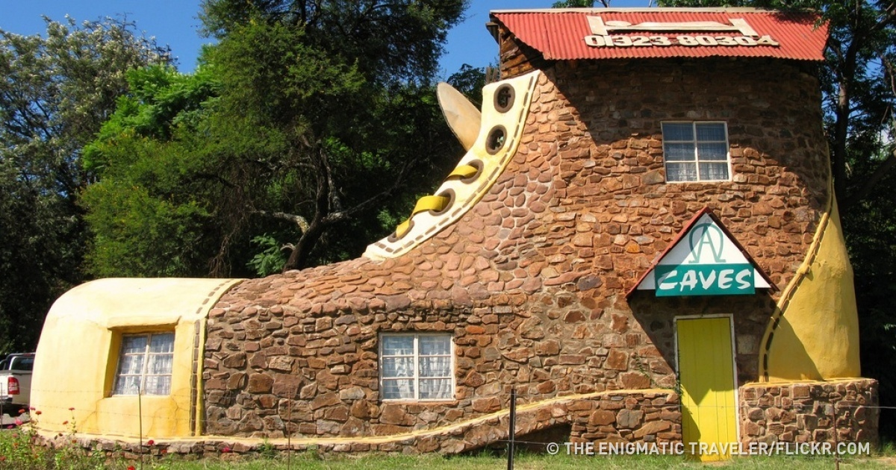

Slide 9
Solve these exercises
1.https://www.liveworksheets.com/worksheets/en/English_as_a_Second_Language_(ESL)/The_house/parts_of_the_house_jj2722kn
2.https://www.liveworksheets.com/worksheets/en/English_as_a_Second_Language_(ESL)/Rooms_in_the_house/Unusual_homes_for_sale_px11448dr (izpusti zadnji dve nalogi)

Slide 10
See you on ZOOM on Tuesday, 2 June 2020.

